Slide 1
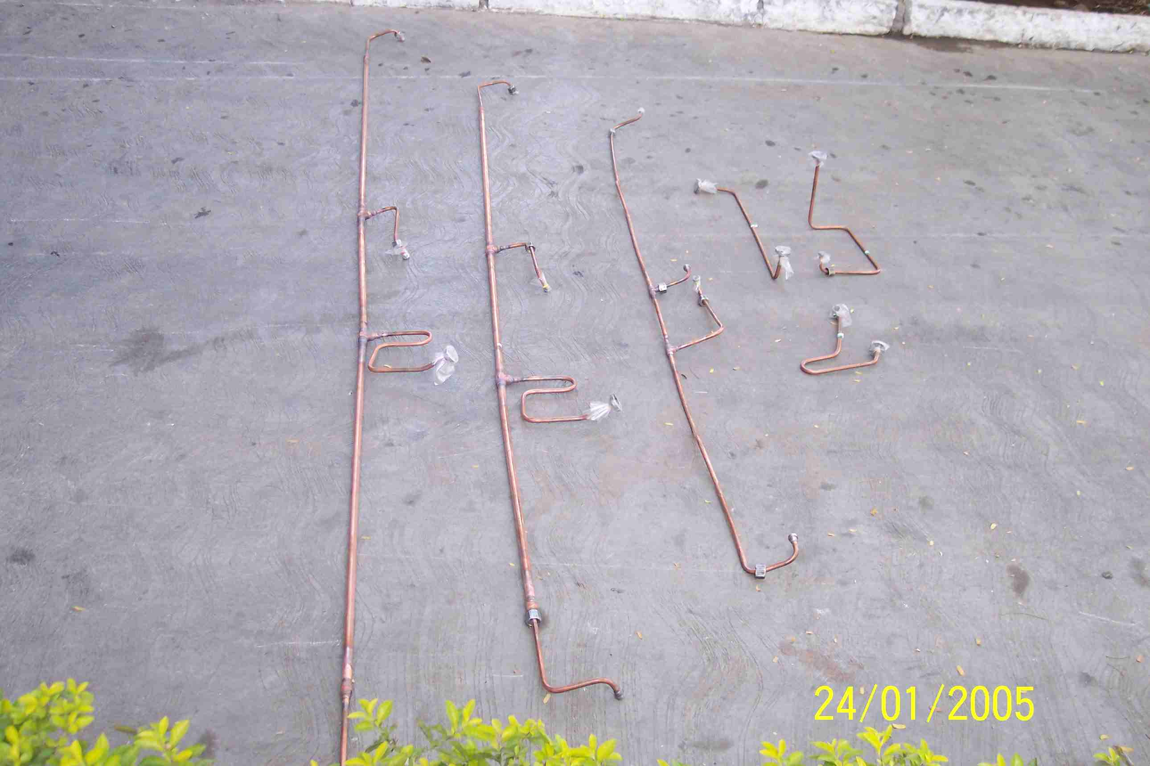
SIEMENS
HVCB SPARES
Small Gas pipe-2, 245KV, 50KA CB
S4805015001

